Slide 1
Current icons used in games
There are many Icons used in current space games and they mostly come under:
Health
Armour
Repair
Damage
Speed
Ammo

Slide 2
The Icons we should use for our game
For our game we will use:
Repair
Damage
Ammo

Slide 3







Repair

Slide 4
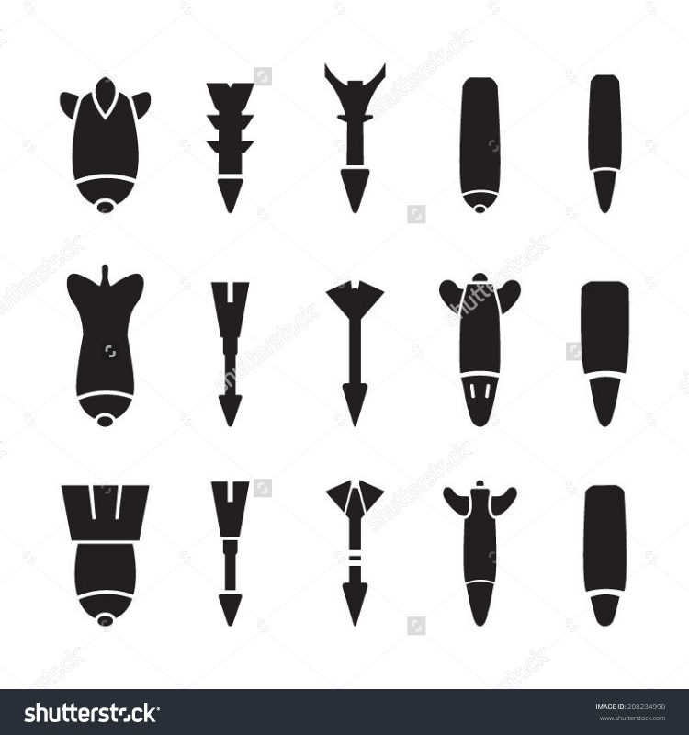




Ammo

